Slide 1
TRC1902: Capillary Pressure Sensor Testing to Identify Curing Regimen in Freshly Placed Concrete Bridge Decks
Samuel Spann, Cameron D. Murray, Ph.D., Micah Hale, Ph.D., P.E.

Slide 2
Overview
Shrinkage in concrete
CPSS Explanation
Promoting shrinkage cracking
Current progress
Preliminary results
Future work

Slide 3
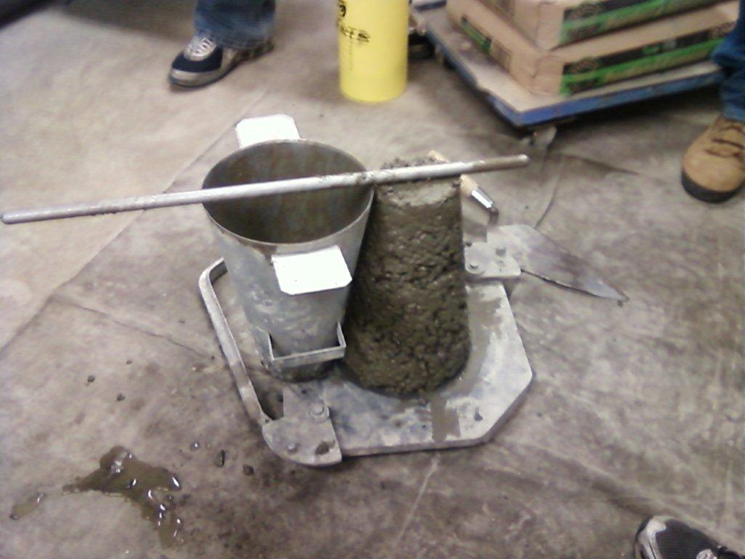
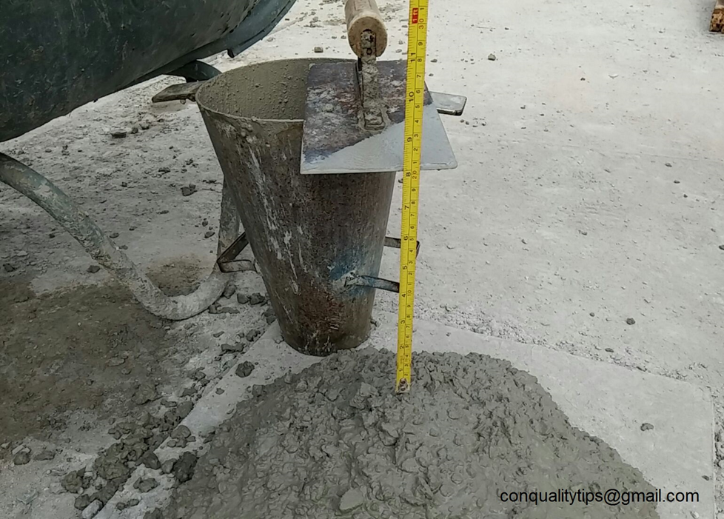
Shrinkage in concrete
Extra water is used in concrete mixtures (workability)

Slide 4
Shrinkage in concrete
When water leaves the concrete, shrinkage happens
Two main types of cracking:
Plastic shrinkage (before concrete hardens)
Drying shrinkage (after concrete hardens)

Slide 5
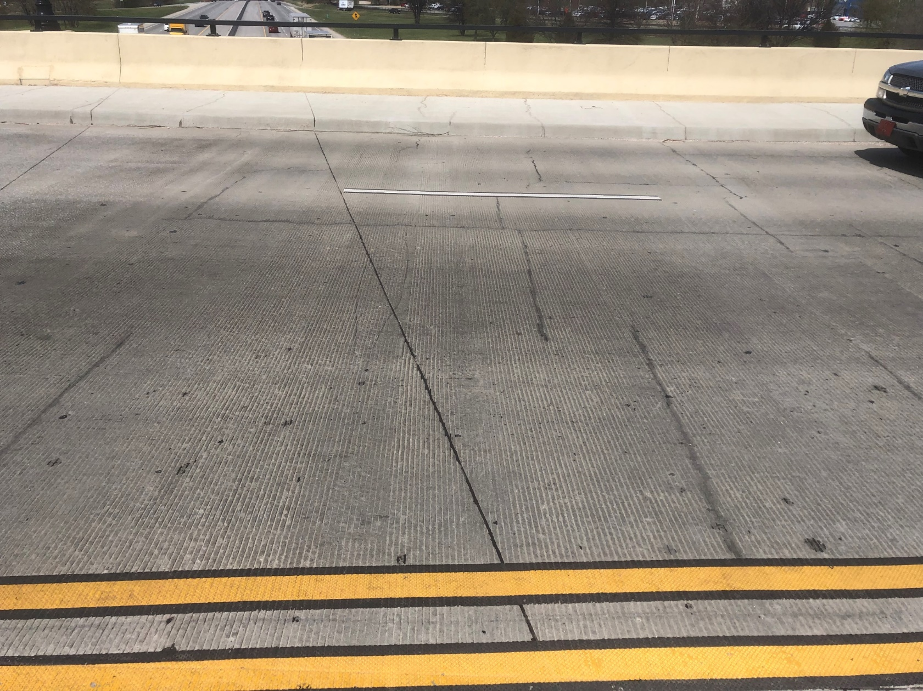
Shrinkage in concrete
Drying shrinkage
Regular intervals
Tend to be deep
Notes:
Elm springs road bridge over I49 in Springdale

Slide 6
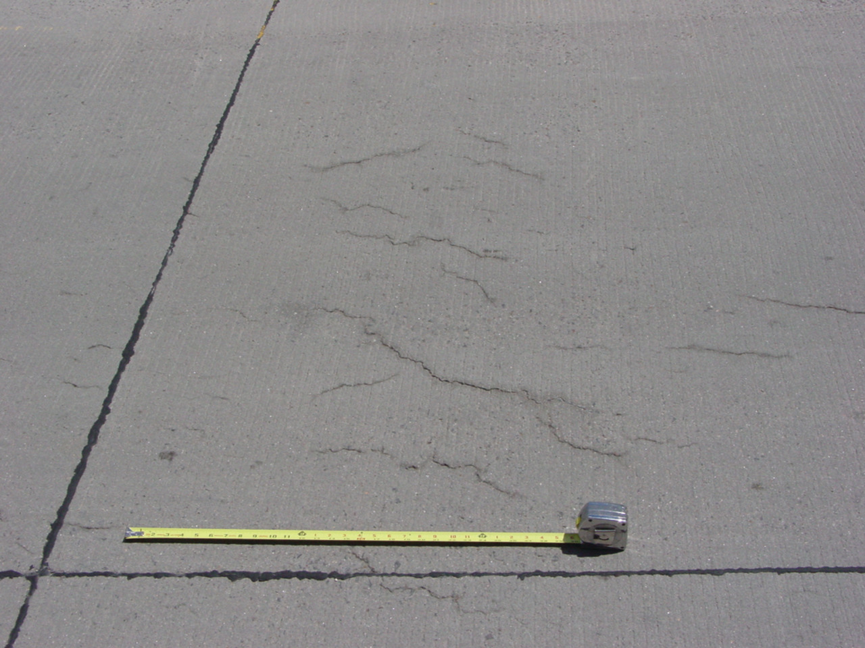
Shrinkage in concrete
Plastic shrinkage
More cosmetic
Shallow cracks
Often random patterns
Occurs before concrete hardens!
https://www.forconstructionpros.com/concrete/equipment-products/article/11487540/plastic-shrinkage-cracking

Slide 7
Plastic shrinkage
Caused by evaporation of bleed water
Bleed water

Slide 8
Plastic shrinkage
Rate of evaporation > bleed water rate = plastic shrinkage cracks

Slide 9
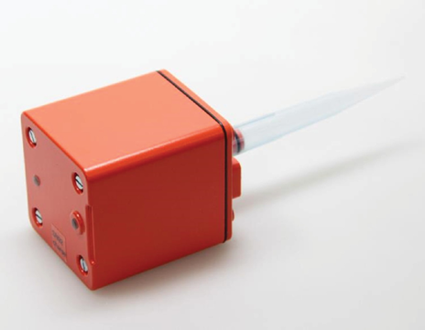
Capillary Pressure Sensor System (CPSS)
Evaporation leads to capillary pressure
Builds up in concrete surface until the strength < stress
We can measure these pressures

Slide 10
Capillary Pressure Sensor System (CPSS)

Slide 11
Capillary Pressure Sensor System (CPSS)

Slide 12
Promoting plastic shrinkage cracking
Increased air temperature
Increased concrete temperature
Increased wind speed
Lead to increased rate of evaporation

Slide 13
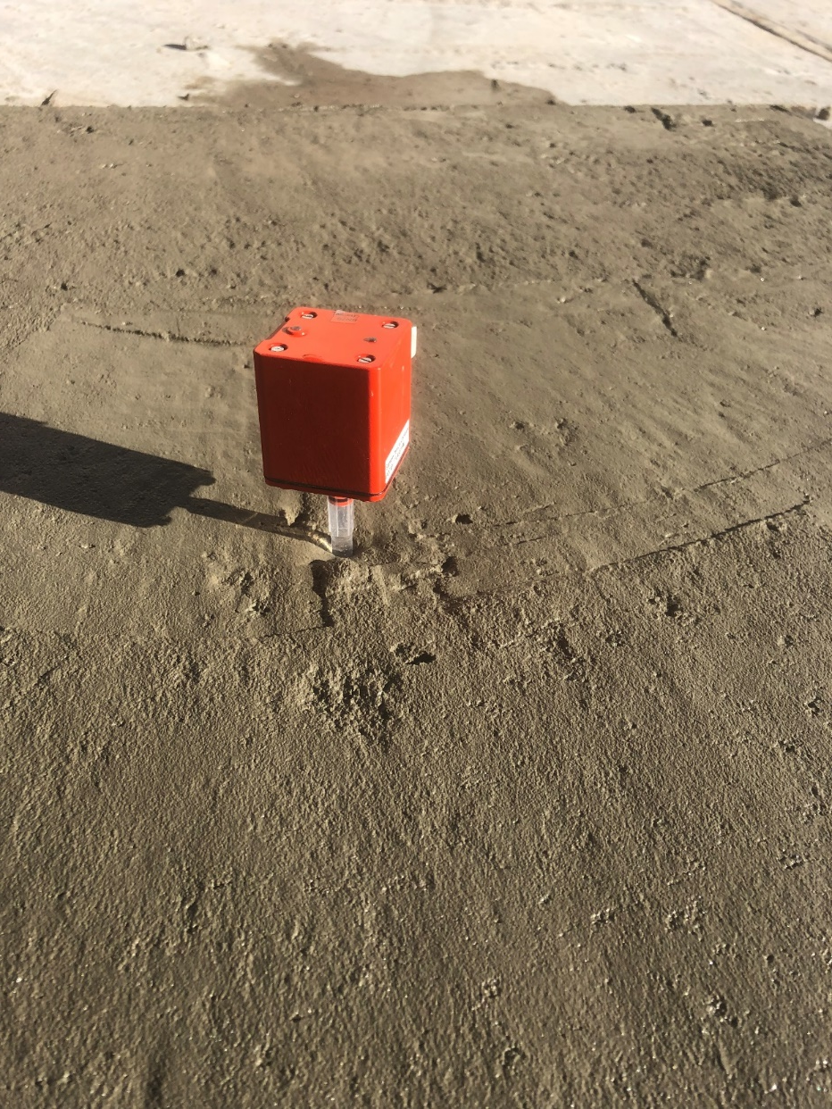
Trying to cause cracking
Notes:
Unsuccessful January Attempt

Slide 14
Trying to cause cracking
Warmer temperatures
Restraint
No restraint = no stress

Slide 15
Formwork changes

Slide 16
Next attempt

Slide 17
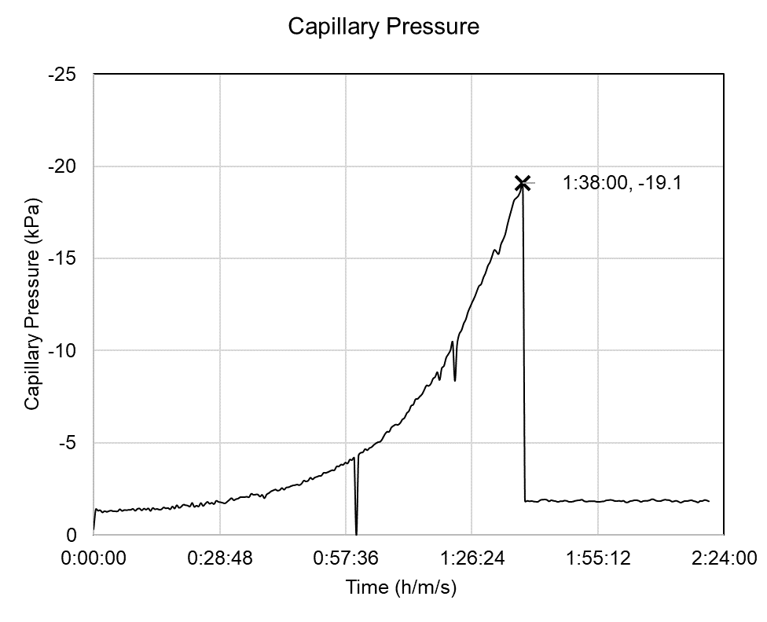
Next attempt – successful!

Slide 18
Current work

Slide 19
Current work
Wet burlap + plastic sheeting
Lithium based curing compound
Other compound (white or clear)
No curing

Slide 20
Curing methods
Selected from ARDOT QPL
WR Meadows 1100 resin based, curing compound (clear)
WR Meadows 1610 wax based curing compound (white)
Sinak 1000 lithium cure
Other method
Wet burlap + plastic sheeting

Slide 22
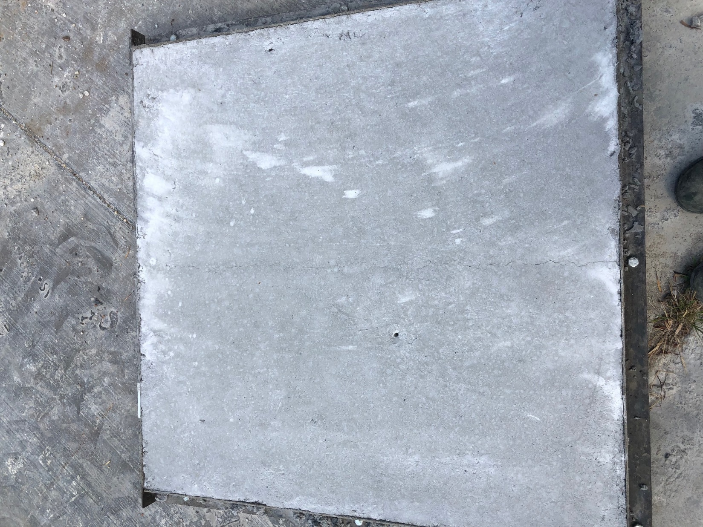

Slide 24
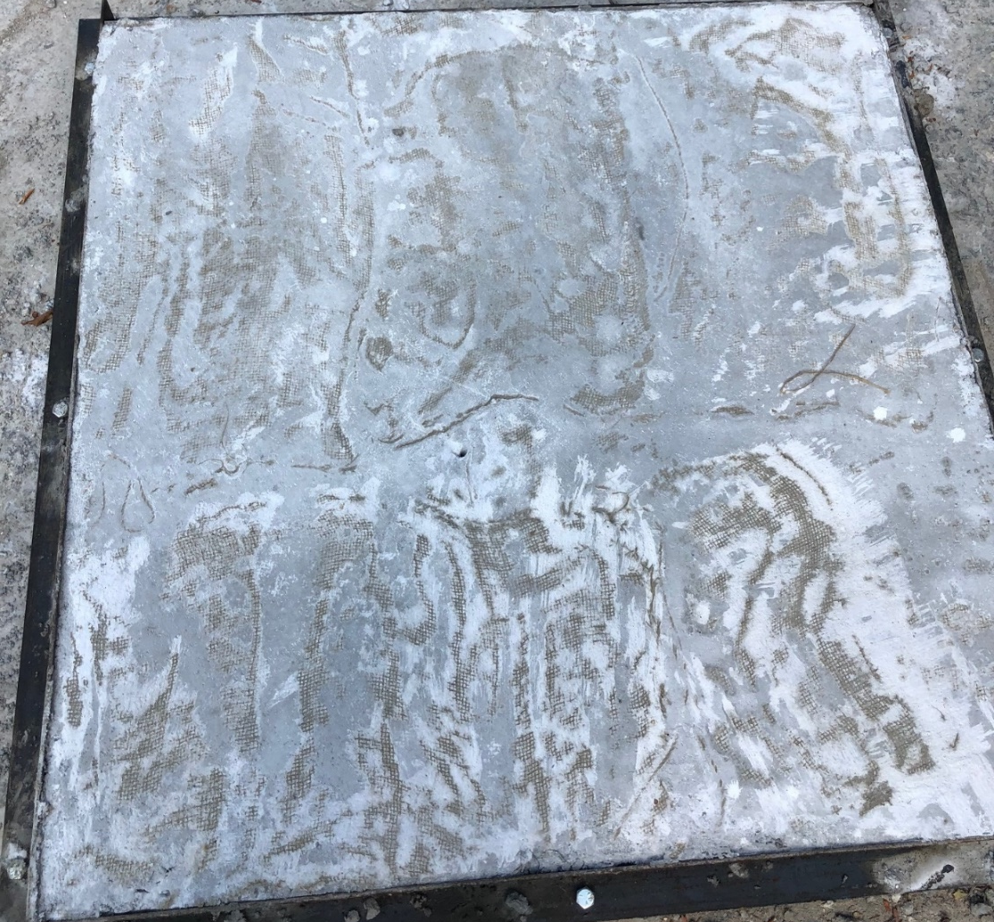

Slide 25
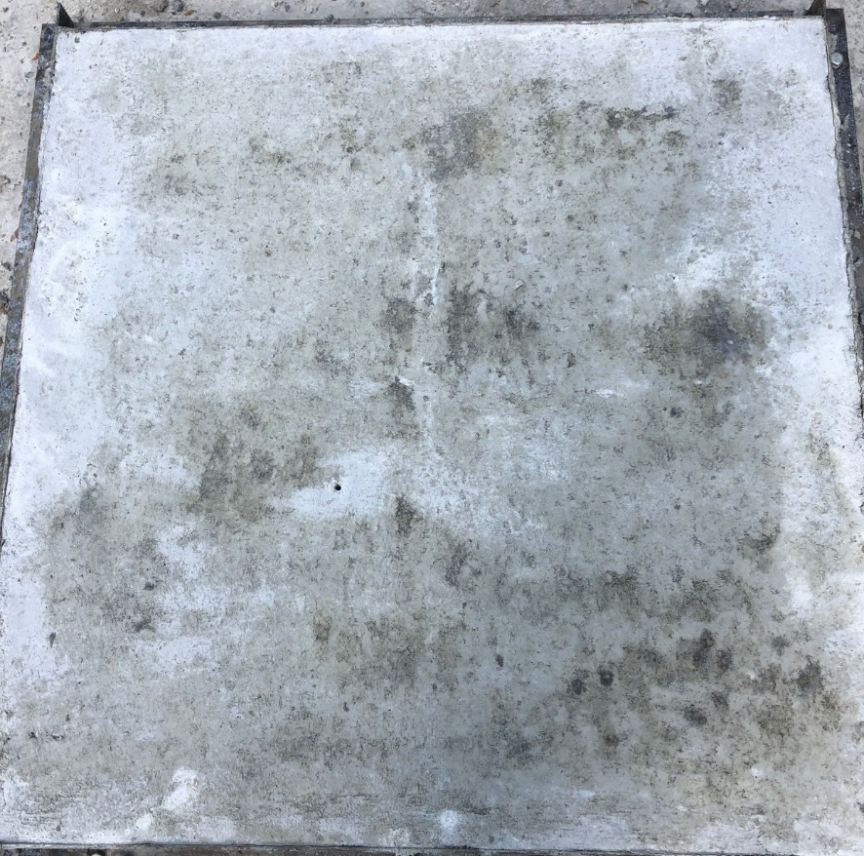

Slide 26
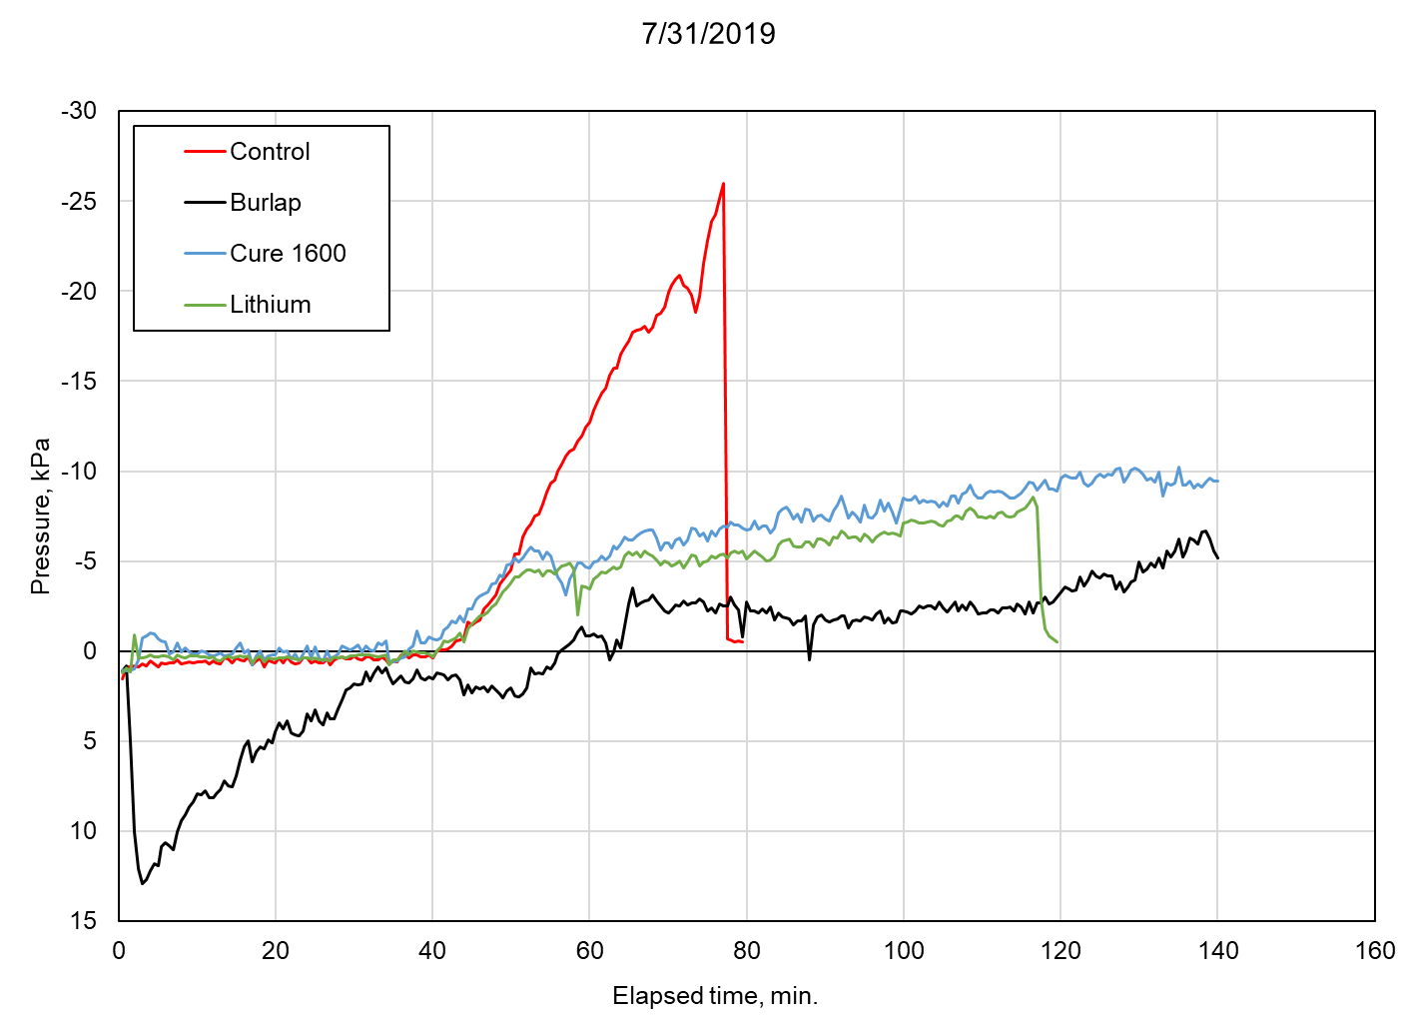

Slide 27
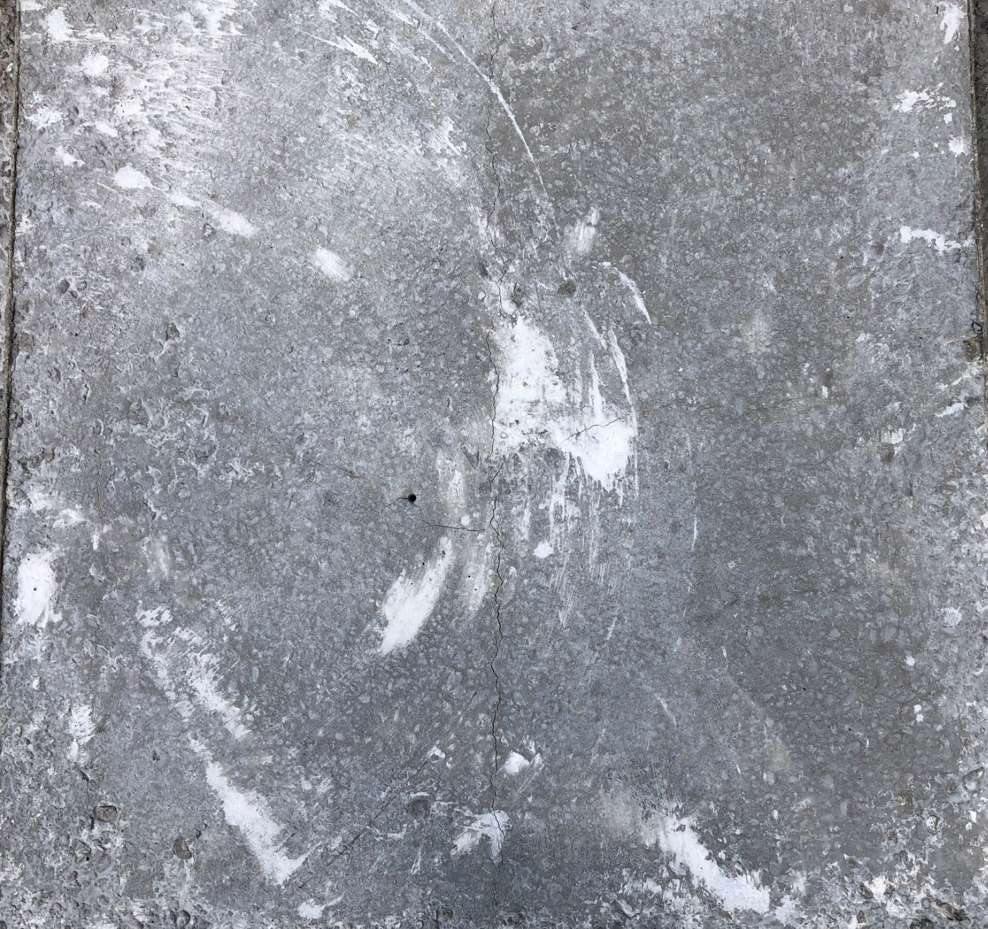

Slide 28
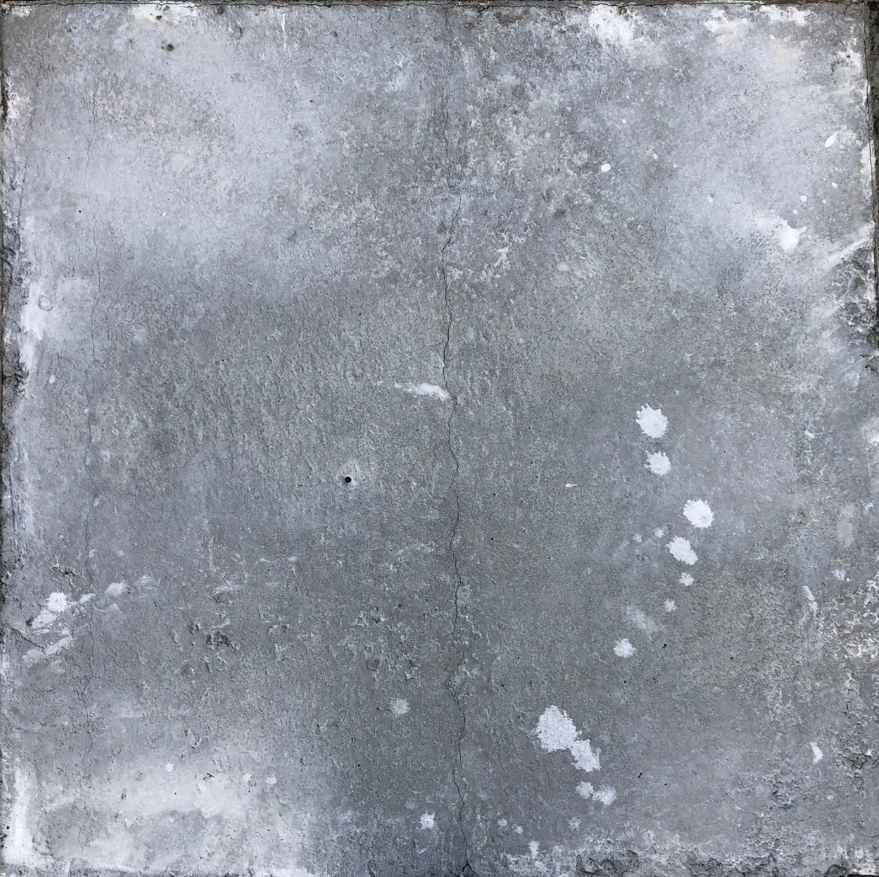

Slide 29
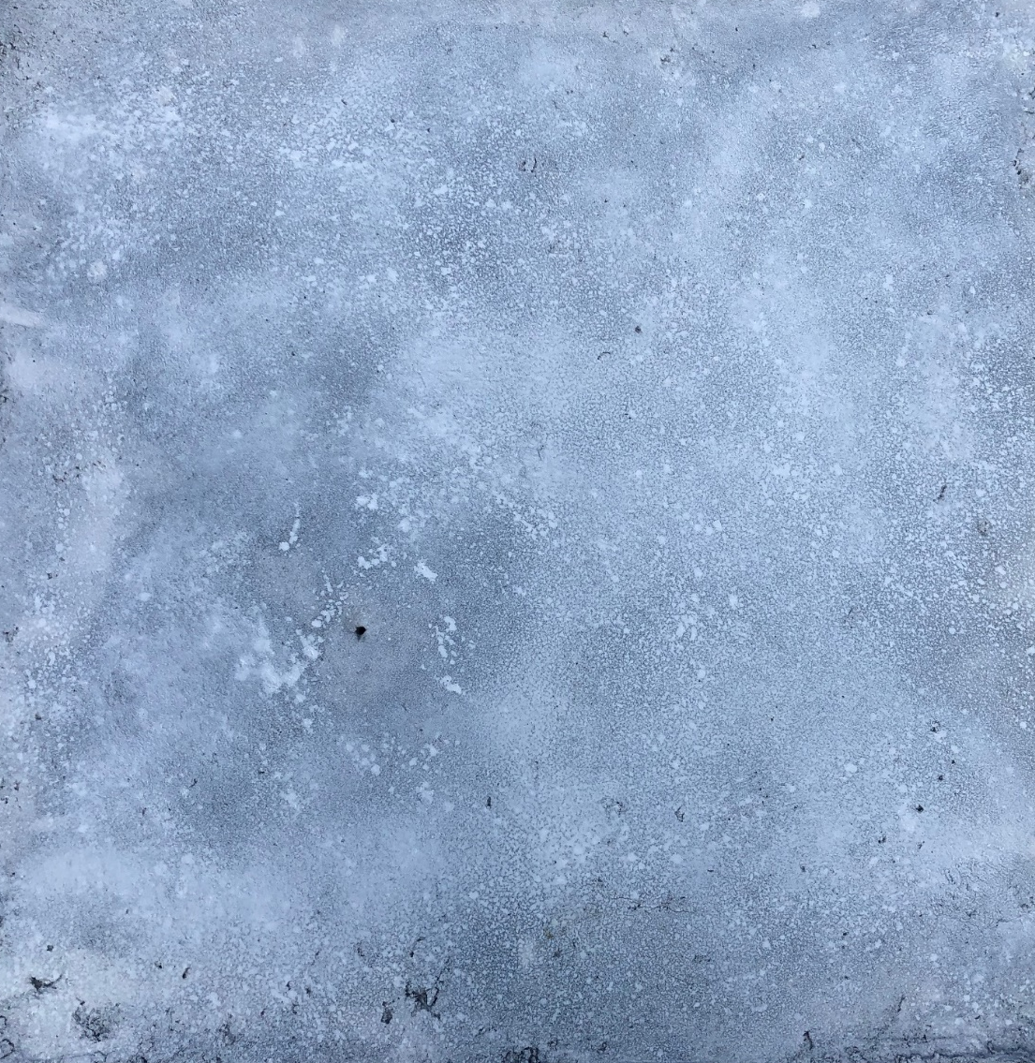

Slide 31
Anticipated results
Comparative study of the effectiveness of curing methods
Data from VWSG and CPSS
Understanding of how to use CPSS
Field trials
Training for ARDOT

Slide 32
Questions?
Contact:
cdmurray@uark.edu

